Slide 1
Presentation On
A Comprehensive Business Solutions Platform
Project Name: Trim
Presented By
Solutions Group
Batch: 15th

Slide 2
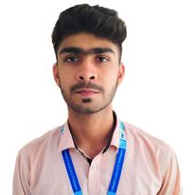
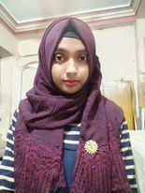
Team Member
Name: Tanvir Hossain Tonmoy Roll: 590975 4th Semester, Computer Department
Name: Nusrat Jahan Roll: 590972 4th Semester, Computer Department

Slide 3
Project Introduction
Trim is a comprehensive business solutions platform that aims to help small and medium-sized businesses navigate the ever-changing business landscape. We understand the unique challenges and goals of small businesses, and our team of experienced professionals works closely with clients to provide customized solutions and expert guidance. Our platform offers a range of services such as market analysis, accounting, business consulting, investment planning, and digital marketing, all aimed at helping businesses improve their overall performance and achieve their goals.
TECHNOLOGY USED
HTML, CSS, and Bootstrap for creating the front-end design and layout of the website.
Font Awesome for providing a wide range of customizable icons for the website.
3.PHP and MySQL for creating the back-end functionality of the website and storing data.

Slide 4

Let's take a deep dive into our project and see what we've accomplished.

